Slide 1

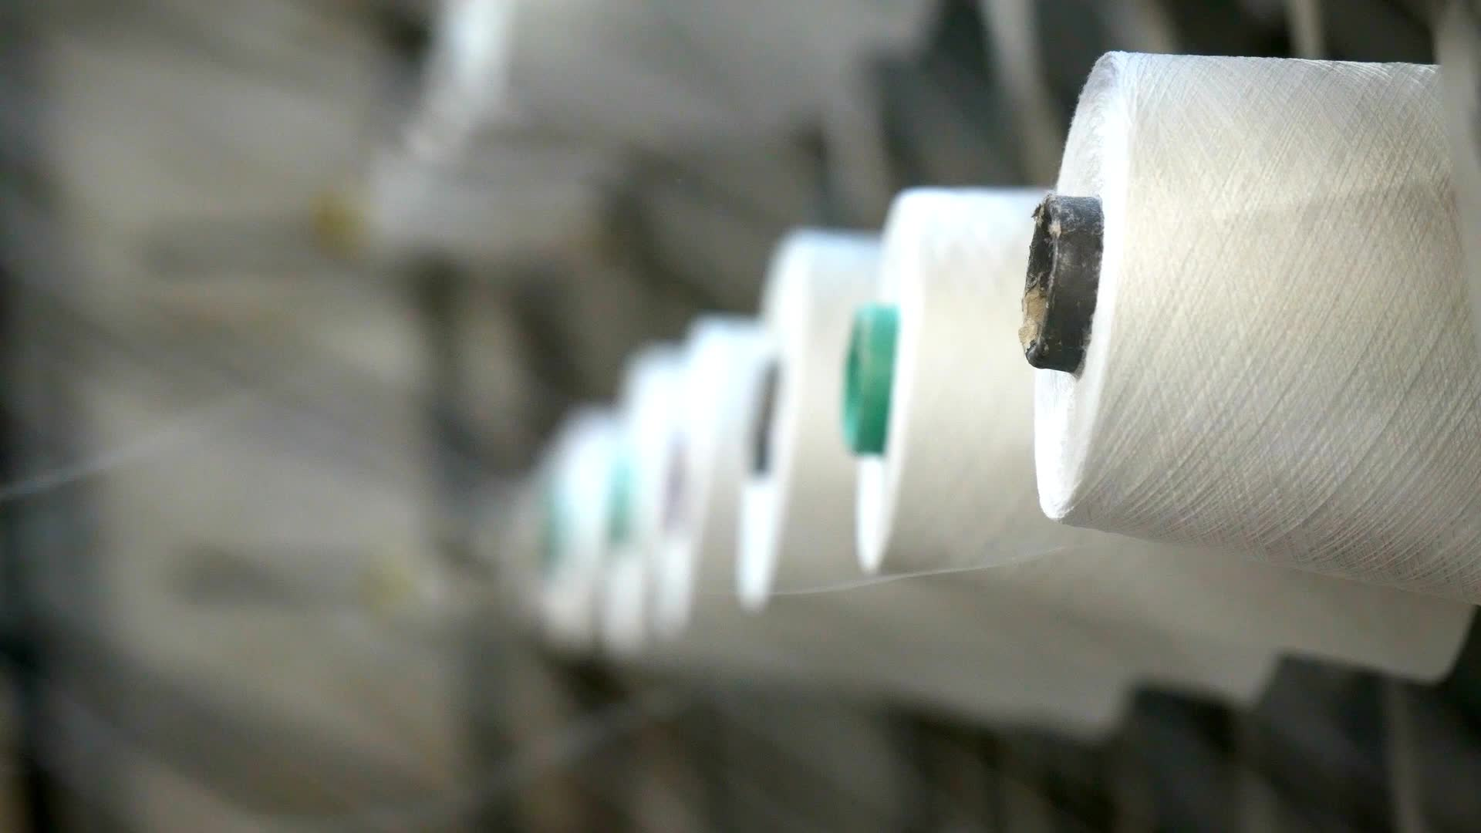
Textile Industry
An Evaluation of Market Opportunities and Challenges
GROUP M-4 (Birmingham)
Fazaludin Shaikh (Leader) (10442561) (B00992652) 25%
Daniella Uwam (10454005) (B00995696) 25%
Hassan Rauf Shaikh (10433414) (B00990809) 25%
Abdul Ahad Khan (10432291) (B00986931) 25%

Slide 2
Why the Textile industry?
Pakistan’s textile industry is a powerhouse, employing millions and driving billions in exports. Low costs, favorable policies, and abundant cotton make it a global player, fueling economic growth and development. (Ahmad et al., 2023)
Incentives: Tax benefits, subsidies
Cost Advantage: Lower labor costs
Strategic Location: Access to multiple regions
Exports: $35.210 billion in 2023
Employment: Over 15 million jobs

Slide 3
background
What is the situation of textile industry in Pakistan?
What is the situation of Pakistan’s textile industry in the world?
Pakistan Clothing Industry (Ahmad et al., 2021)
Workforce: Employs over 15 million people
Raw Material Availability: Fourth largest cotton producer globally.
Government Support: Incentives include tax exemptions and subsidies.
Industry Size: Accounts for about $340.64 billion GDP, 8.5% of GDP.
Pakistan’s Textile Industry In the World (ILO, n.d)
Backbone of the economy: The industry is a major employer and contributor to exports.
Global competition: Facing stiff competition from regional rivals like Bangladesh and India.
Potential for growth: The industry can recover and thrive with the right policies and investments.
Cotton production: Pakistan is a major cotton producer that provides key raw materials.

Slide 4
Cage framework
Cage framework
“The CAGE Framework is a tool used to analyze the differences between countries that can impact international business. It was developed by Pankaj Ghemawat and focuses on four key dimensions:
Cultural Distance Administrative Distance Geographic Distance Economic Distance.” (Prajesh et al., 2020)
Cultural Distance
Language Barriers
Administrative Distance
Government Policies and Regulations
Geographic Distance
Physical Difference
Economic Distance
Economic Development
Cultural norms and Values
Religious Differences
Political Stability
Legal frameworks
Institutional Framework
Different Time Zones
Transportation and Logistics Difference
Various Consumer Incomes
Different Market Structure
Different Business Practices
Notes:
Cultural Distance:
Language barriers: English vs. Urdu, Punjabi, Sindhi
Differences in cultural values and norms
Religious differences: Predominantly Christian vs. predominantly Muslim
Administrative Distance:
Differences in government policies and regulations
Political stability: UK stable vs. political fluctuations in Pakistan
Legal and institutional frameworks: Business-friendly in the UK vs. complexities in Pakistan
Geographic Distance:
Physical distance between countries
Differences in time zones: 4-5 hours
Transportation and logistics challenges
Economic Distance:
Differences in economic development: Developed economy in the UK vs. emerging market in Pakistan
Variations in consumer income levels
Differences in market structures and business practices

Slide 5
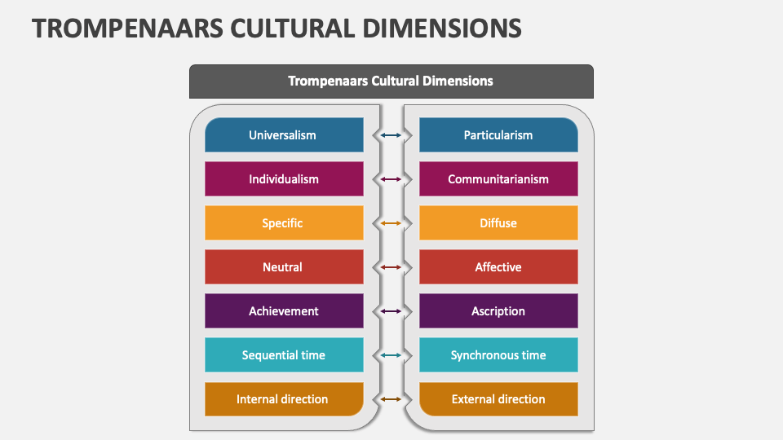
Cage framework
Cultural distance
The Trompenaar’s Cultural dimention theory found that people across cultures differs in specific and often predictive ways
(Trompenaar’s 1993).
Analysing the Challenges and Opportunities in The Cultural Distance;
Challenges
The Religious Difference,UK’s is predominantly Christian 59.59 vs Pakistan predominatly Isalm 96.4%
Uk direct communication style Vs Pakistan more collective and direct communication style,could lead to musunderstanding.
Source; https://www.collidu.com/presentation-trompenaars-cultural-dimensions
Opportunities
The UK work culture focuses on efficiency, punctuality,respect to rule Vs the Paskistan strong hierarchical structure will set a righ work environment.
Uk predominant language is English Vs Pakistan de facto language,English language formalised in 1973.
Notes:
Cultural Distance:
Language barriers: English vs. Urdu, Punjabi, Sindhi
Differences in cultural values and norms
Religious differences: Predominantly Christian vs. predominantly Muslim
Administrative Distance:
Differences in government policies and regulations
Political stability: UK stable vs. political fluctuations in Pakistan
Legal and institutional frameworks: Business-friendly in the UK vs. complexities in Pakistan
Geographic Distance:
Physical distance between countries
Differences in time zones: 4-5 hours
Transportation and logistics challenges
Economic Distance:
Differences in economic development: Developed economy in the UK vs. emerging market in Pakistan
Variations in consumer income levels
Differences in market structures and business practices

Slide 6
ADMINISTRATIVE DISTANCE
The Administrative distance, emphasizes on the importance of understanding how differences in administrative and institutional factors can create barriers or opportunities for businesses operating across borders (Pankaj Ghemawat 2007)
Governmnt Policities &
Regulations
Uk’s Stronge intellectual
Property rights protection
VS Pakistan mixed legal
System and common law.
Political Stability
Uk’s high political stability and strong
Institiopnal framework VS Pakistan’s political flunctuations and instability related to corrupyion and security
Legal and institutional
Frameworks
Uk’s Transparent legal system and stronge
Protetions for property rights VS Pakistan
Bureacratic inefficiencies and inconsistent
Enforcement of laws.
Key Components

Slide 7
Geographic DISTANCE
Strategic Location: Proximity to key markets in South Asia, Central Asia, and the Middle East, offering a gateway for trade expansion.
Access to Raw Materials:
As a major cotton producer, Pakistan offers an abundant supply of raw materials, reducing procurement costs and supply chain disruptions.
Lower Transportation Costs:
Geographic proximity can lower shipping costs and transit times for UK companies importing textiles from Pakistan.
Infrastructure Development:
While improving, Pakistan's infrastructure, including transportation and logistics, may not meet the standards required by UK businesses.
Geopolitical Risks: Political instability and regional tensions can impact the reliability of supply chains and business operations.
Cultural and Regulatory Differences: Navigating different business practices, regulatory environments, and cultural norms can pose challenges for UK companies entering the Pakistani market.
Opportunities
Challenges

Slide 8
Economic
Cost-Effective Production:
Lower labor costs in Pakistan provide a competitive advantage for UK companies looking to outsource manufacturing.
Incentives and Subsidies:
The Pakistani government offers various tax incentives and subsidies to the textile sector, which can benefit UK investors.
Growing Consumer Market:
With a growing middle class, Pakistan presents an expanding market for high-quality textiles and apparel from the UK.
Currency Fluctuations:
Exchange rate volatility can affect profitability and pricing strategies for UK companies operating in Pakistan.
Economic Instability:
Periodic economic instability, including inflation and fiscal challenges, can impact the business environment.
Tariff and Trade Barriers:
Potential tariffs and trade barriers could increase costs and complicate the import-export process for UK firms.
Opportunities
Challenges

Slide 9
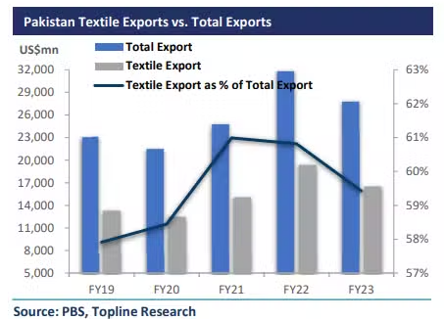
What lies ahead for the textile industry in Pakistan?
What is the revenue of textile industry in pakistan
In Financial years:
2010 – 11 $13.8 billion
2018 – 19 $13.33 billion
2019 – 20 $12.5 billion
2020 – 21 $6.05 billion
2021 – 22 $19.3 billion
2022 – 23 $16.5 billion
Technological Advancements: Innovations in textile manufacturing and production processes.
Rising Demand for Sustainable Textiles: Growing consumer interest in eco-friendly and sustainable textile products.
Supportive Government Policies: Government initiatives and policies that favor the growth of the textile industry.
International Partnerships and Investments: Opportunities for collaboration with global brands and foreign investments in the textile sector.

Slide 10

recommendations
Conclusion
Expanding into Pakistan offers UK companies opportunities due to a growing middle class, lower costs, and government incentives. Key challenges include navigating regulatory complexities, political instability, and infrastructure issues. Cultural differences and administrative hurdles also require attention. Pakistan's strategic location and the China-Pakistan Economic Corridor (CPEC) enhance access to South Asian and Middle Eastern markets, boosting trade prospects.
Conduct Market Research for local preferences and trends
Ensure compliance and IP protection.
Develop competitive pricing and product strategies.
Focus on innovation and quality.
Implement risk management practices.
Utilize government incentives and trade agreements.
Monitor and adapt to market changes.
Recommendation's

Slide 11
References
references
Ahmad, A., Hussain, A., Akash, R.S.I., Zahoor, S., Yasmin, S. and Jaffri, N.R., 2023. Do demographic factors affect work-stress? A case study of textile and clothing industry in Pakistan. Pakistan Journal of Agricultural Sciences, 58(1).
Ahmad, A., Javed, I.Q.R.A., Abrar, U., Ahmad, A., Jaffri, N.R. and Hussain, A., 2023. Investigation of ergonomic working conditions of sewing and cutting machine operators of clothing industry. Industria Textila, 72(3), pp.309-314.
Goworek, H., Oxborrow, L., Claxton, S., McLaren, A., Cooper, T. and Hill, H., 2020. Managing sustainability in the fashion business: Challenges in product development for clothing longevity in the UK. Journal of Business Research, 117, pp.629-641.
Increasing productivity and competitiveness through labour law compliance in Pakistan's textile sector - ILO. Available at: www.ilo.org
Nouinou, H., Asadollahi-Yazdi, E., Baret, I., Nguyen, N.Q., Terzi, M., Ouazene, Y., Yalaoui, F. and Kelly, R., 2023. Decision-making in the context of Industry 4.0: Evidence from the textile and clothing industry. Journal of Cleaner Production, 391, p.136184.
Peters, J. and Simaens, A., 2020. Integrating sustainability into corporate strategy: A case study of the textile and clothing industry. Sustainability, 12(15), p.6125.
Prajesh, N., Yadav, A., Gourkhede, R., Praveenkumar, B., Steiner, A. and Boomishankar, R., 2020. Ferroelectric Behavior of an Octahedral Metal‐Ligand Cage and Its 2D‐Connected Cage Framework. Chemistry–An Asian Journal, 15(20), pp.3275-3280.

Slide 12
Thank you!

